Slide 1
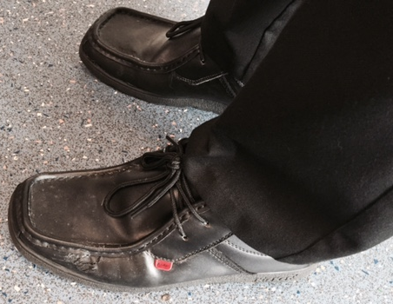
Shoes ☺

Slide 2
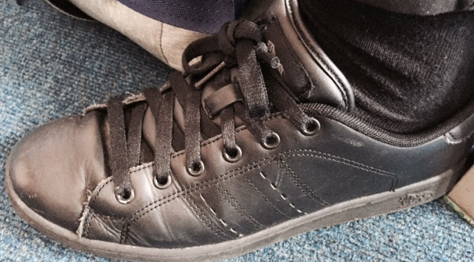
Not Shoes ☹

Slide 3
If in doubt don’t buy!!
Mr Burns and Mr Burrows are the ‘shoe gatekeepers’
They will make the final decision

